Slide 1
Software engineering
Final Presentation
권수환, 이석재, 이승수

Slide 2
Contents
Basic concept of system
Prototype system following SW engineering
Requirement analysis
user scenario
Functional & non-functional requirements
System modeling & Architecture design
Integration & Testing
Flow chart of used SE Tools
Javadocs, Github
Junit, Espresso, Proguard
Video record & alpha & beta testing
Result
Remaining work to do

Slide 3
Basic concept of system - Object description
What we made : Cooperating tool for elaborating Ideas with other people.
Program Type : Android application
Due date : 2019 June 3rd
Development Tool : Android Studio, starUML
Core Function :
1. Sketch & Text Relaying Tools
Requirement: should be drawn on point smoothly
2. Networking
Requirement: display real-time sketch board

Slide 4
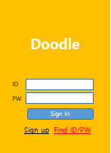
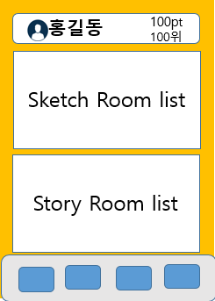
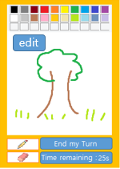
Basic concept of system - prototype system

Slide 5
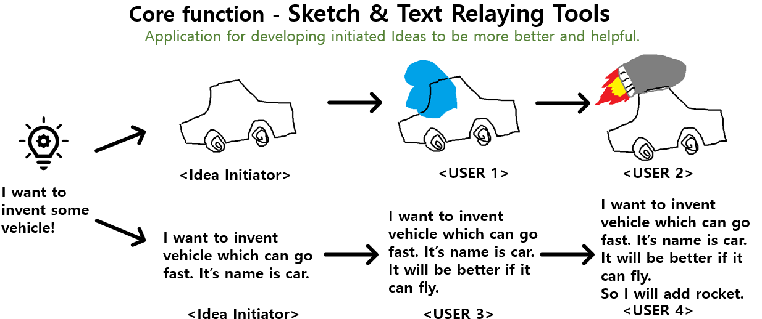
Requirement Analysis -user scenario

Slide 6
Requirement Analysis
•Functional Requirement
-Login Function
-Make secure personal information
-Draw picture and write notes in relay
-Evaluate saved ideas
•Non-functional Requirement
-Real time image sharing
-Simple & intuitive UI
-Endurable for frequent member changes
-Portability: run at heterogeneous environments

Slide 7
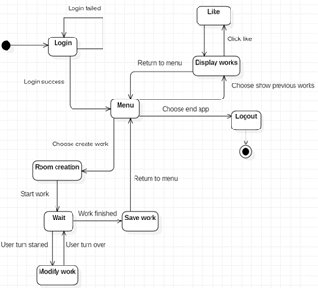
Requirement Analysis -user scenario
Expected requirements from User Scenario
• Login
Sign up quickly
• Main menu
Stable connection between menu and room
Pin up most voted ideas on top
• Paint board
Minimum response time
Support various painting tools
<Activity diagram of User Scenario>

Slide 8
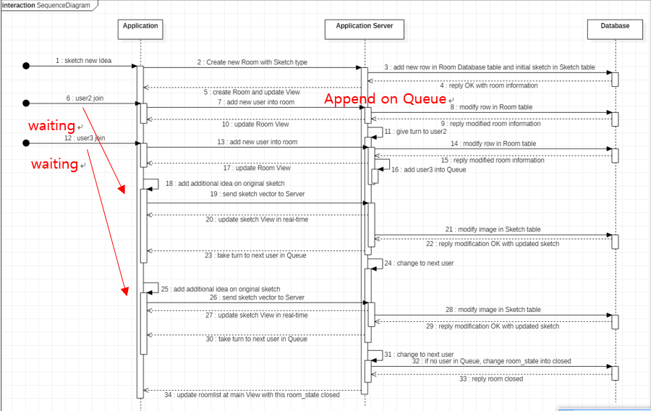
System Modeling & Architecture design
Sequence Diagram
<painting tool>
Application
App server
Database
When previous user end sketching,
Next user can start
Notes:
그림판에 대해 설명

Slide 9
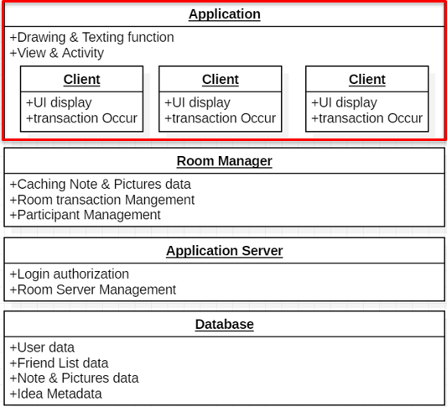
System Modeling & Architecture design
Layered Architecture
<focused on painting Tool>
Application(with Client)
Room manager
Application server
Database
We will make presentation focused on painting
function because it is essential to our App.
Notes:
그림판에 대해 설명

Slide 10
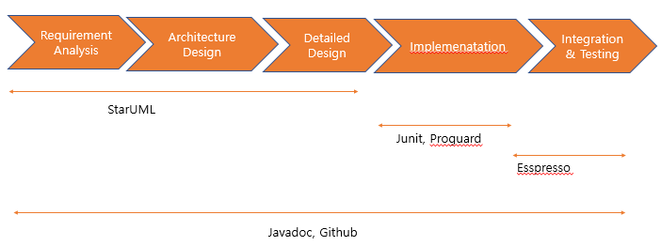
Integration & Testing
Flow chart of used SE Tools

Slide 11
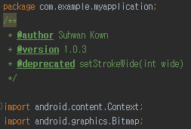
Integration & Testing-javadocs
javadoc is inner API in android studio
Define an organic connection for each method and what role it plays for each layout
Quickly understand what each code is doing and what more is needed in the future

Slide 12
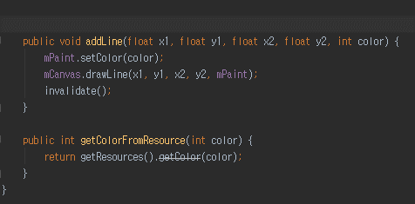
Integration & Testing-javadocs(documentation)
You can add javadocs comments by simply pressing '/ **' followed by Enter.
You can add each tag with @ back content
@author : name
@version : info. of version
@deprecated : dead code
@param : description of parameter

Slide 13
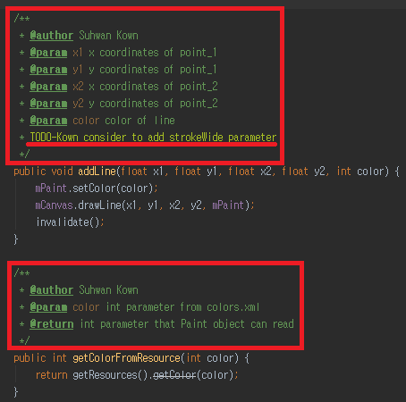
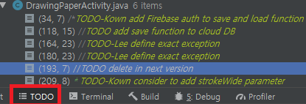
Integration & Testing-javadocs(TODO)
'TODO' for easy identification of areas that need integration in the future
Press the ‘TODO button’ below to select the relevant part and move to the code automatically.

Slide 14
Integration & Testing-Github(git)
AS layout, Java activity, and DB are developed, structure are keep changing.
Under github, you can see what has changed for each version and help you maintain reciprocity from those changes.
starUML, github, and javadocs helped the team to work together.
github link: https://github.com/teddy309/Doodle_TermProject
Notes:
Our github link: https://github.com/teddy309/Doodle_TermProject

Slide 15
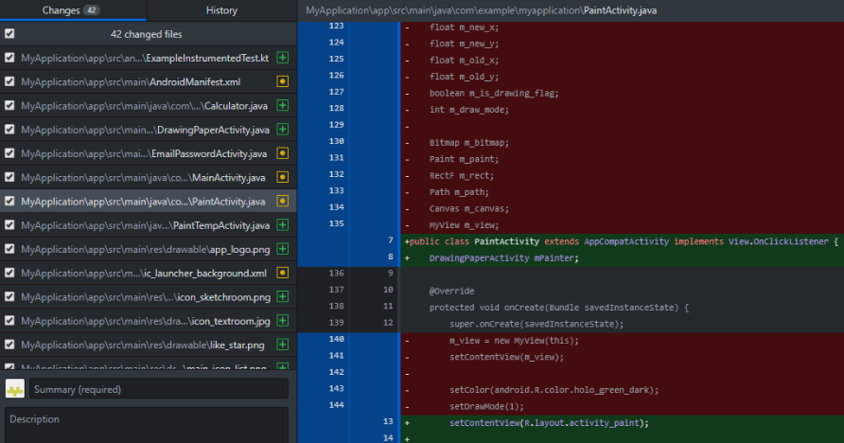
Integration & Testing-Github(git)
Notes:
Our github link: https://github.com/teddy309/Doodle_TermProject

Slide 16
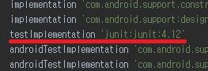
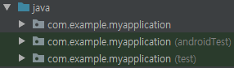
Integration & Testing-Junit
Inner SDK of android studio
Allows testing of each unit (method-by-method)
Each test folder has different roles
androidTest - Testing, including methods in projects such as gradle
test - Testing method that has Low-dependency with android.
Including JVM only.

Slide 17
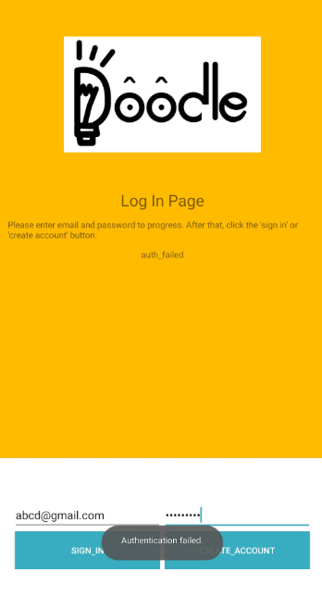
Integration & Testing-Junit(unit test)
do unit testing with hand by hand
connect device - build APK - testing one by one
Waste of cost(time)
make easy test cases for unit Testing using Junit

Slide 18
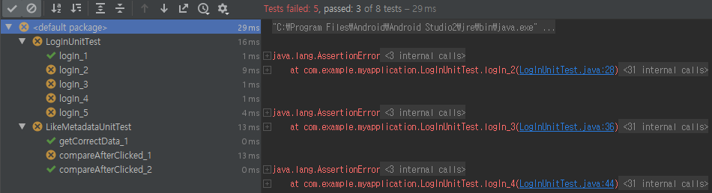
Integration & Testing-Junit(unit test)
Improvements after applying unit testing
Login verification : in login function, test validation of email and password.
Test the contents of the metadata of the picture received from the DB of the server
Notes:
네트워크 사용 많아 Firebase 쓸때 제한 안넘기도록 조심해야한다

Slide 19
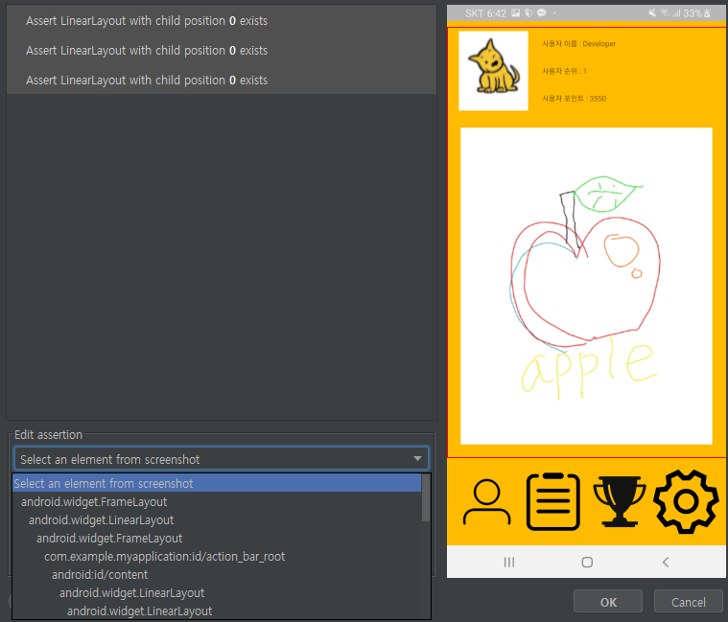
Integration & Testing-Espresso(UI testing & record)
Support in default Android Studio
Can perform UI testing and record operations
(similar with Ranorex recorder)
Use for final testing of the components that will interact with the user
can minimize developing cost
for real executing apk

Slide 20
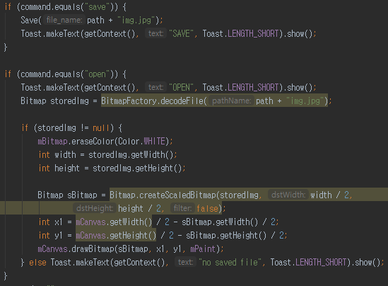
Integration & Testing-proguard(dead code analyze)
Separate each action to method to improve development and maintenance efficiency
→ Cause of dead code
proguard can handle these problems

Slide 21
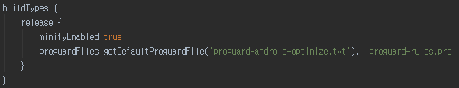
Integration & Testing-proguard(obfuscating)
An external person can decompile apk to analyze the code.
proguard prevents this by obfuscation of code

Slide 22
Integration & Testing-alpha & beta testing
The results can be different between compiling on a single virtual OS or smartphone and testing directly with APK. We try catch and improve it.
Alpha test
When communicating with the coordinates of the line through Firebase 's real time DB, the coordinates are intertwined and the vector value is drawn as error. This is solved by having one line communicate with one string value.
Beta test
UI design and user convenience are not suitable for mobile use. Default eraser and pen thickness is not appropriate

Slide 23
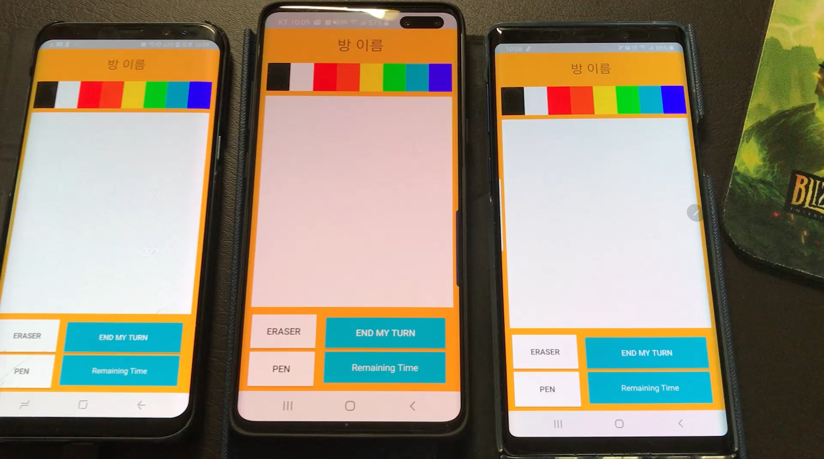
Integration & Testing-video record

Slide 24
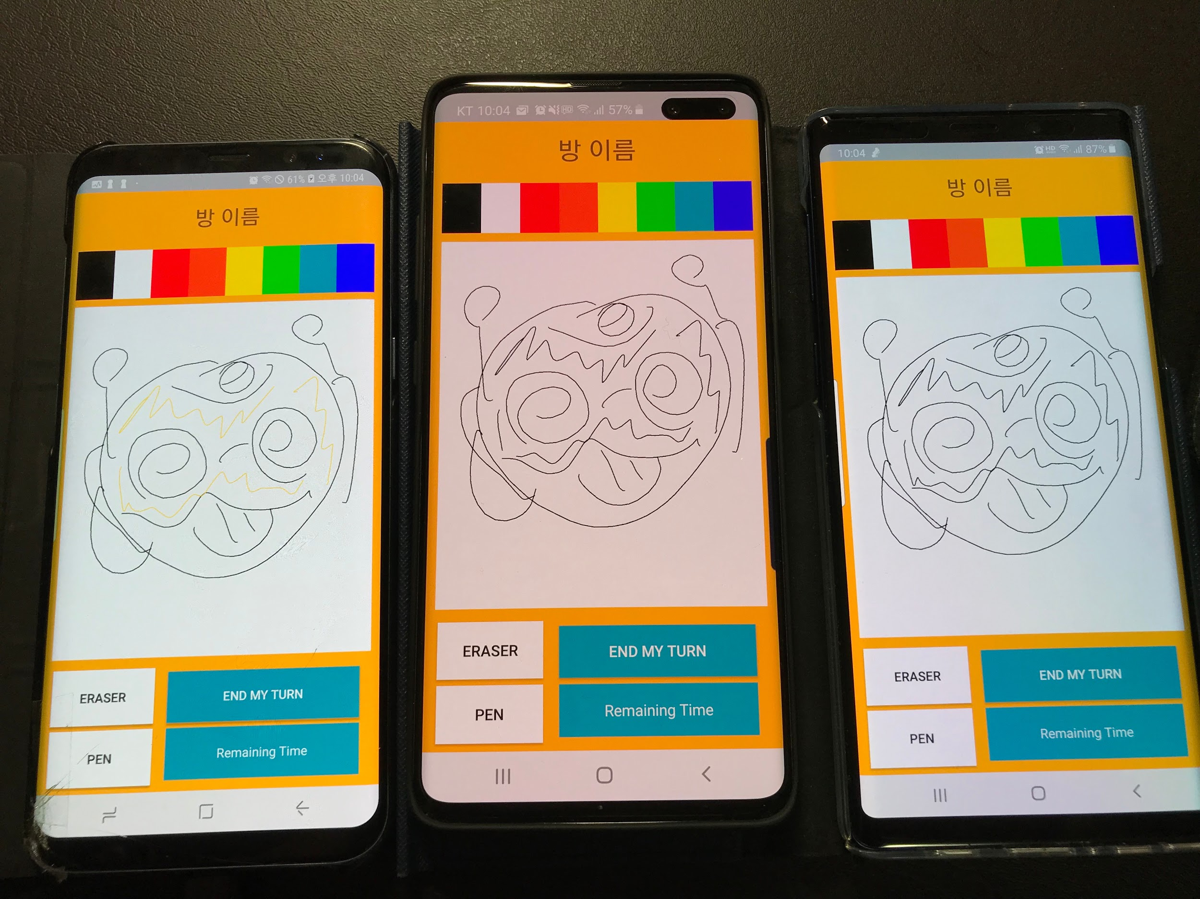
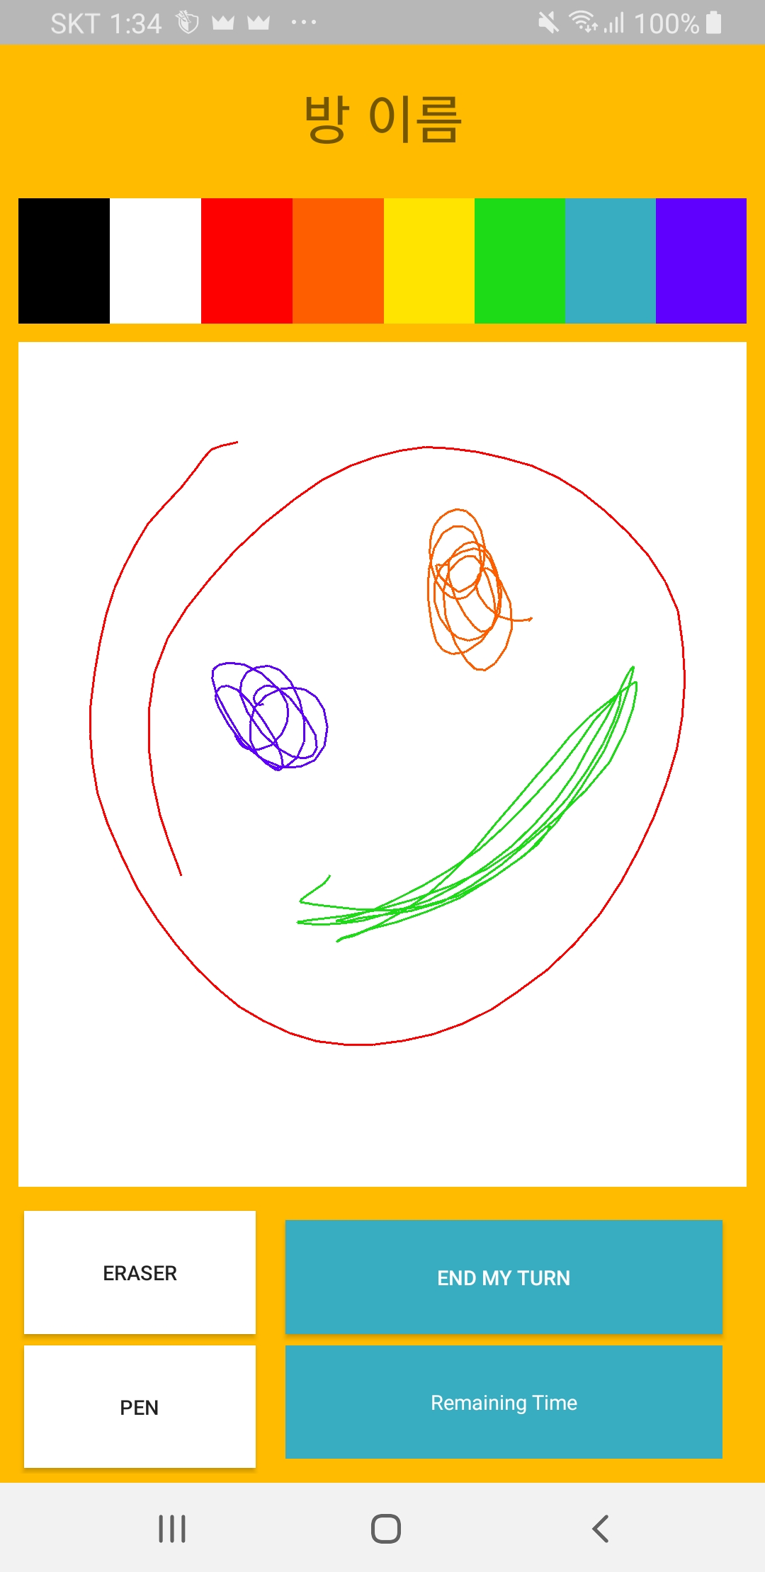
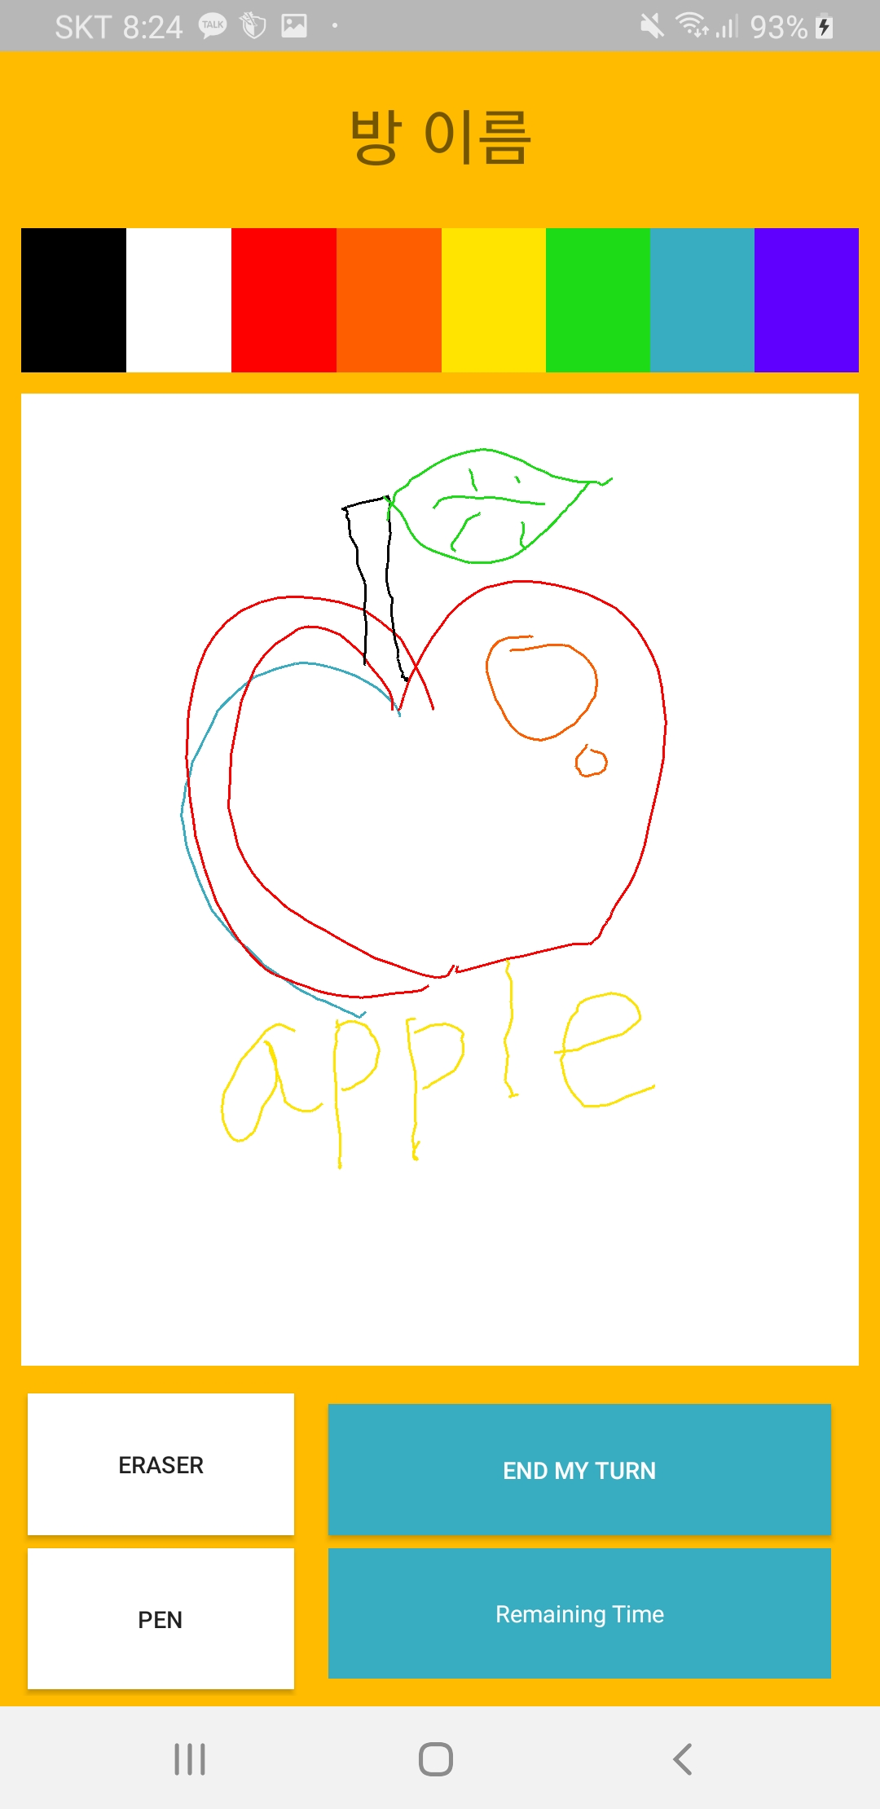
Integration & Testing-alpha testing
Color data transmission error → fix

Slide 25
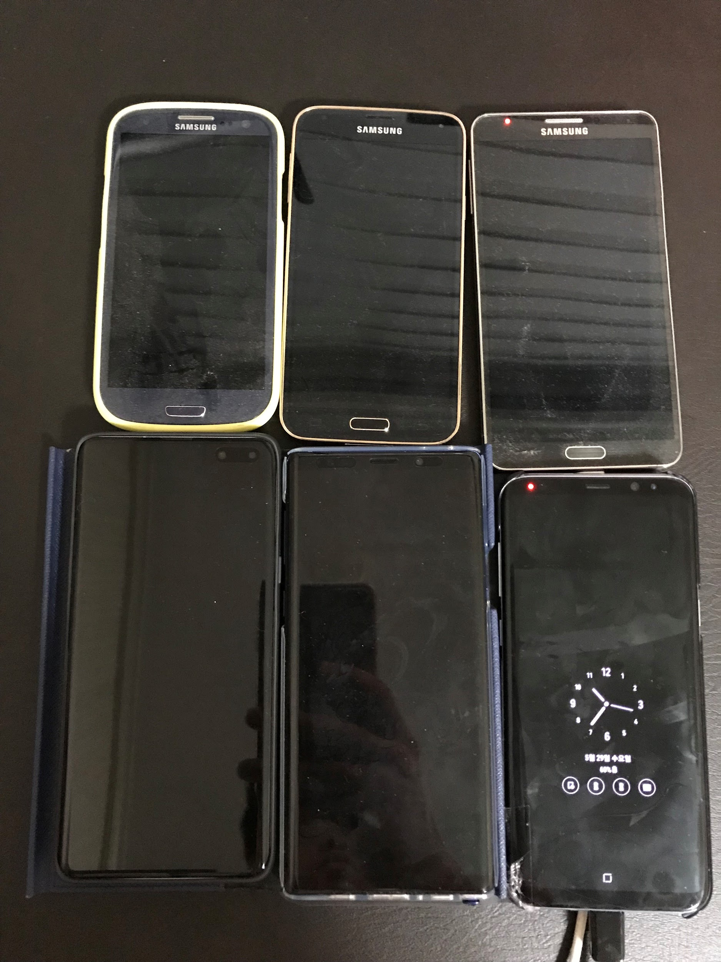
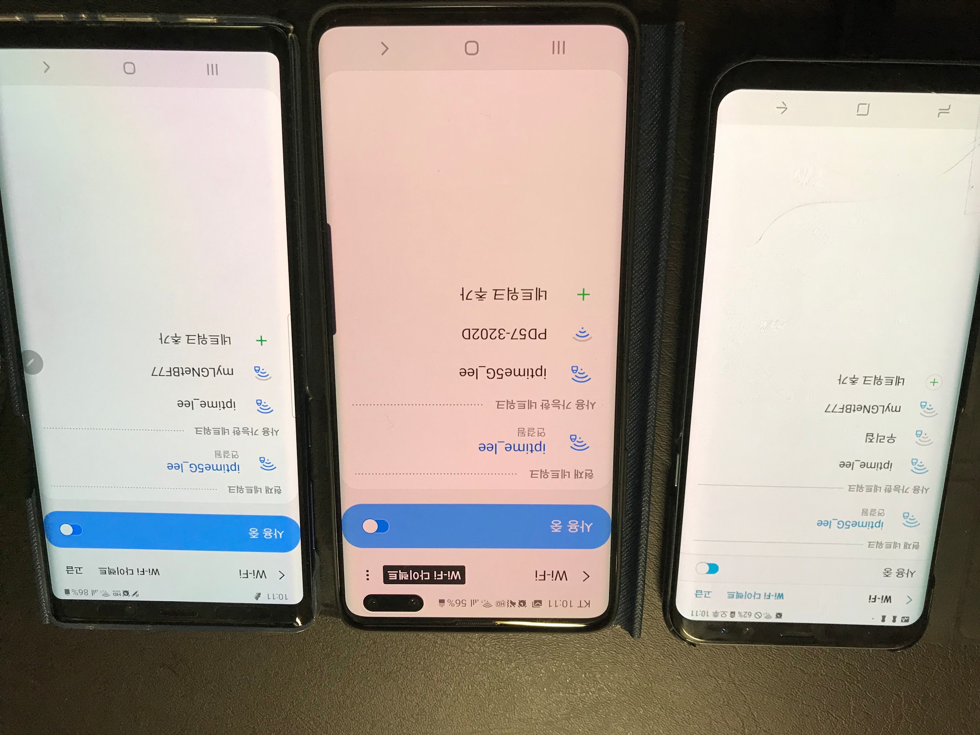
Integration & Testing-beta testing
S3
S5
N3
S10 5G
N8
S8+
Testing with many users → 3 issues are catched

Slide 26
Integration & Testing- results
1. Has no network problems
Allows communication between devices using the same router, different speed band → Need to distinguish clearly
2. Compatibility issues according to android version
Not compatible with Android marshmallow version and below.
3. Performance depends on Wi-Fi signals Noise is occurred when network signal is low or bad

Slide 27
Remaining work to do
Add social networking function
Setting room title and type function
Public/private Authority for Room and Idea
Trying to minimize transactions at application

Slide 28
References
Javadocs
https://www.jetbrains.com/help/idea/2018.3/getting-started-with-android-development.html
https://stackoverflow.com/questions/17291785/how-to-generate-javadoc-comments-in-android-studio
https://blog.naver.com/candy_0406/220951949449
https://www.jetbrains.com/help/idea/2018.3/todo-example.html
Junit testing
https://developer.android.com/studio/test
https://blog.naver.com/dajung674/221376544132
Android studio testing tools
https://developer.android.com/training/testing
Proguard
https://developer.android.com/studio/build/shrink-code
https://medium.com/ics-lab/%EC%95%88%EB%93%9C%EB%A1%9C%EC%9D%B4%EB%93%9C-%EC%95%B1-%EB%82%9C%EB%8F%85%ED%99%94-proguard-dexguard-%EB%A5%BC-%ED%95%B4%EB%B3%B4%EC%9E%90-1-%ED%94%84%EB%A1%9C%EA%B0%80%EB%93%9C-%ED%8E%B8-799999a43c4d

Slide 29
End of PPT

